Slide 1

A Retail Marijuana Dispensary in Boston’s Back Bay
Community Impact Meeting

Slide 2
551 Boylston Street, Boston, MA
Copley Connection seeks to operate an adult-use retail marijuana facility at 551 Boylston Street.
Copley Connection
Founded by Josh Zakim and Senam Kumahia
Advised by Victor Chiang
Unanimous approval from Boston Cannabis Board on February 22, 2023 & Zoning Board of Appeal on April 11, 2023

Slide 3
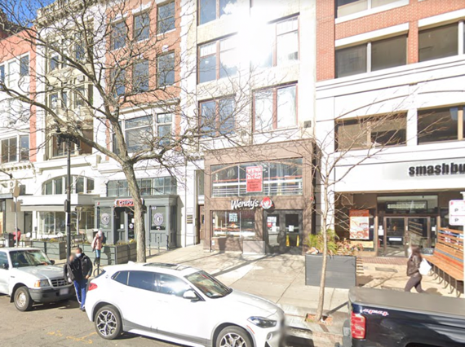
Location
Proposed Site:
551 Boylston St
Former Wendy’s restaurant
Zoning District: Back Bay
6,359 square feet of total space

Slide 4
The Location (Buffer Zone)
Buffer Zone
There is only one open dispensary in the ½ mile buffer
One approved site is located 0.4 miles away across the train tracks on Columbus Ave in the South End
We believe the high density of retail foot traffic easily supports a second dispensary in Back Bay

Slide 5
Public Access
Map of T’s, parking garages and blue bikes
Public Access Within a ½ Mile
4 Train stations (Arlington, Back Bay, Copley & Prudential)
34 Bus Stops (Routes 9, 10, 11, 39, 43, 55, 501, 504)
17 Blue Bike Stations
38 Paid Parking Lots

Slide 6
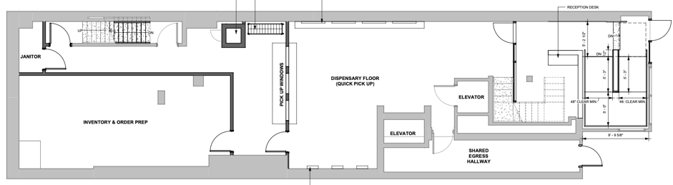
The Property
First Floor
Indoor security desk with significant space for queuing to avoid any lines on the sidewalk
Our design will mean our windows will not need to be frosted and will be designed to beautify the existing store front
No cannabis merchandising on the 1st floor visible to Boylston St
Express pickup
No loitering policy on Boylston St; monitored by our staff on the sidewalk
Notes:
Do we need to include the SF?

Slide 7
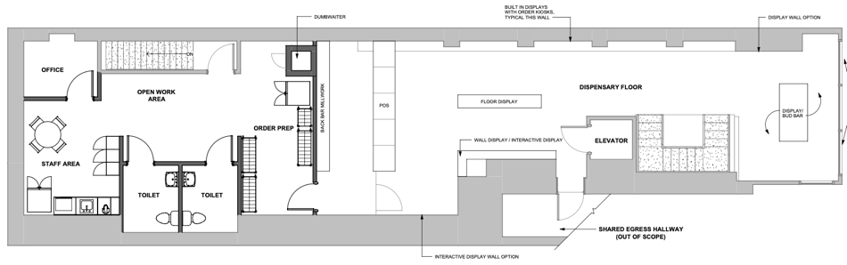
The Property (continued)
Second Floor
Primary retail space for customers
Elevated from the ground level so not visible from Boylston St and will not required frosted glass
Basement (not shown)
Our location includes basement space for back of house operations, which is accessible by the rear alley
All deliveries will come through the alleyway avoiding any double parking on Boylston St

Slide 8
Nuisance Prevention
No individual pre-rolls will be sold
Trash will be disposed of in locked dumpster in the rear alleyway; no rodent impact
Vehicular traffic control: No deliveries on Boylston St; call ahead and pick up option for customers to avoid extensive queuing
Crowd control will be handled via an interior waiting room and a dedicated outdoor waiting area
There are no outdoor speakers; there is no added noise impact
Hours of Operation are 9am-11pm; these are commercial hours closing earlier than local restaurants and bars

Slide 9
Community Impact & Avoidance of Nuisance
The Copley Connection is committed to being a good neighbor and making a positive impact on our community. We have identified key areas where we can leverage our resources to benefit the greater community:
Copley Square Park: We intend to work with the Boston Parks Department, the Friends of Copley Square, and other stakeholders to make significant and sustained contributions to the park. These Include but are not limited to additional maintenance shifts, volunteer cleanups, and contributing to public events in the park.
Avoidance of Nuisance: Copley Connection will take steps to ensure there is no negative impact on the surrounding area and that it is a net positive for the community. Copley Connection will not create a nuisance for the neighborhood.
Cleanliness and Access: Boylston Street is a busy retail corridor and as part of our regular operations we plan to assign staff to monitor and regularly clean up the public spaces in front of our location. In coordination with the Boston Public Works Department, we would supply and service additional trash receptacles available to the public. We will also conduct monthly staff volunteer days to clean-up Copley Square.
Transportation : Copley Connection is uniquely well served by public transit and cycling infrastructure. We will encourage all guests and employees to walk, bike, or take public transit to our location. The Copley Connection will provide a transit subsidy and complimentary Bluebike memberships to all employees. We will also provide bike parking available to customers and employees. Our outdoor security staff will not permit any customer to double park on Boylston St.
Public Safety: Once operational our location will be monitored 24/7 by high-resolution security cameras, during our open hours dedicated security staff will be tasked with ensuring that there is no loitering in or around our entrance.
Giving Back: Set aside percentage of profits to support community groups and initiatives.

Slide 10




Safety & Security
Copley Connection’s Security Plan will ensure that the premises is safe and protected for all patients, caregivers, staff, visitors, and the general public.
Copley Connection will engage Integrated Security Group to design, implement and monitor the security system.
Pursuant to 935 CMR 500.110(1)(a)-(o), Copley Connection will implement sufficient safety measures to prevent unauthorized entrance into the facility and theft from occurring.
In accordance with 935 CMR 500.110(5), Copley Connection will have a security system to prevent and detect diversion, theft or loss of marijuana product including diversion to minors.

Slide 11



Safety & Security (Continued)
Pursuant to 935 CMR 500.110(5)(a)-(f), our security system shall include, but is not limited to: perimeter alarms; failure notification system; duress alarm; video cameras in all areas containing marijuana; 24-hour recordings that are retained for at least 90 days, contain a date and time stamp and can be exported as still images; and the ability to remain operational during power outages.
Access to said systems will be limited to personnel essential to security operations, law enforcement, the security company and the Commission.
All equipment shall be in good working order at all times.
Deliveries will be discreet and randomized throughout the week. All deliveries will be made in the rear alleyway bringing in all products directly into our basement back of house space and then into our secure vault. Security staff will meet all deliveries and stay with delivery vehicles until they depart.
Our security will perform routine security perimeter checks to ensure that there is no loitering, consumption on site and to prevent the illegal double parking of cars

Slide 12
Safety & Security Customer Experience
ID Verification
Pursuant to 935 CMR 500.110, Copley Connection’s security protocols will implement sufficient safety measures to prevent unauthorized entry and the theft of product:
Confirm the potential customer’s age as twenty-one (21) or older prior to entering the facility’s waiting room and show room. (935 CMR 500.110 (1)(a))
Implement the latest technologies to confirm the validity of identification cards or other documentation to prevent unauthorized access, prevent pass backs, and notify security personnel if the ID was previously scanned before and/or if it is on a banned list
Copley Connection will utilize technology from IDScan.net

Slide 13
Why Us?
The Copley Connection’s founders and location are a strong fit for Boston.
Copley Connection
Locally owned and operated
Proven history of working with and giving back to Boston
Large retail storefront easily accommodates all customers inside of the space; no impact to neighboring businesses
High traffic retail location of Boylston St with only one other retail store within the 1/2-mile buffer
Site is easily accessible by public transportation

